Slide 1
Ch06_Concurrent Programming

Slide 2
Contents
01_Introduction
02_Monitors
03_Java Monitors
04_Java Multithreading Case Study : Part III:
Producer/Consumer Relationship in Java
05_Java Multithreading Case Study : Part IV:
Circular Buffer in Java

Slide 3
01_Introduction
A surge of interest in concurrent programming languages
Can express more natural solutions to problems that have parallel characteristic
The true hardware parallelism possible with multiprocessors and distributed systems can only be realized through concurrent programming
Concurrent programming is much more difficult than sequential programming
Harder to write, debug, modify, and prove correctness

Slide 4
02_Monitors (1/9)
Monitor
An object that contains both the data and procedures
Perform allocation of a particular (or group of) serially reusable shared resource
Monitor data(resource) is accessible only within the monitor
Resource allocation using monitors
A thread must call a monitor entry routine
Mutual exclusion is rigidly enforced at the monitor boundary
Only one thread at a time is allowed to enter
A thread that tries to enter the monitor when it is in use is made to wait by the monitor
The monitor to return the resource
The thread that has the resource will call a monitor entry routine to release the resource
Merely free the resource and wait for another requesting thread to arrive
The monitor entry routine calls signal to allow one of the waiting threads to enter the monitor and acquire the resource
To avoid indefinite postponement
a monitor gives a higher priority to waiting threads than to newly arriving ones

Slide 5
02_Monitors (2/9)
Condition Variables have a queue
A thread inside a monitor uses a condition variable to wait on a condition outside the monitor
Before that thread can reenter the monitor, the thread calling signal must first exit the monitor
Signal-and-exit monitor
A thread immediately exits the monitor upon signaling
Signal-and-continue monitor
A thread inside the monitor to signal that ‘the monitor will soon become available’
Maintain a lock on the monitor until the thread exits the monitor

Slide 6
02_Monitors (3/9)
Simple Resource Allocation with Monitors
Use when several threads are contending for a resource that requires exclusive access.
State variable (=inUse)
Keeps track of whether the resource is in use or not
Condition variable (=available)
Waited on by a thread finding the resource unavailable
Signaled by a thread returning the resource

Slide 7
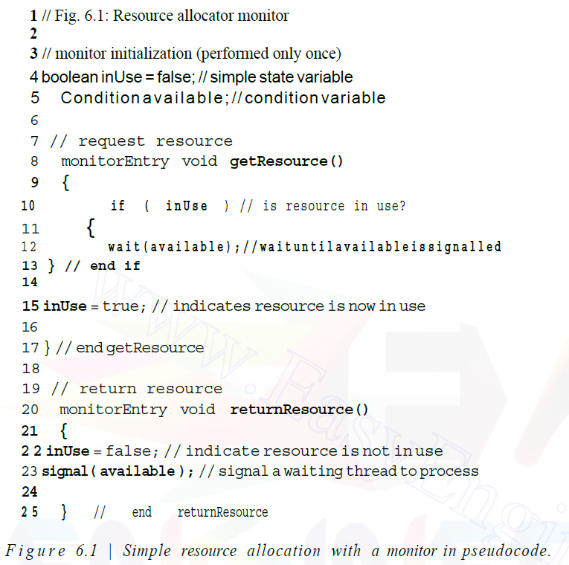
02_Monitors (4/9)
Simple Resource Allocation with Monitors
Several threads are contending for a resource that requires exclusive access
T7
available
T₄
T₅
T₆
T₇
. . .
signal
Wait
T3

Slide 8
02_Monitors (5/9)
Monitor Example: Circular Buffer
Implementation of the solution to the producer/consumer problem
Use an array to implement the circular buffer
The producer deposits data in the successive elements of the array
The consumer removes data in the order in which they were deposited (FIFO).
The producer can be several items ahead of the consumer
The producer fills the last element of the array
When the producer produces more data, it must "wrap around" and again begin depositing data in the first element of the array
The fixed size of the circular buffer
The producer will occasionally find all the array elements full
The producer must wait until the consumer empties an array element
The consumer finds the array elements empty
The consumer must wait until the producer deposits data into an array element
_{readPosition}
1
2
3
-1
-1
Producer
0
Consumer
4
1
_{writePosition}
3
2
circularBuffer[]

Slide 9
Circular Buffer
BUFER_SIZE=5
_{occupiedSlots=0}
Producer T_{n}
Consumer
T_{n+1}
_{writePosition}
_{readPosition}
code outside monitor
wait(hasSpace)
Put Character
signal(hasData)
code outside monitor
-1
-1
-1
-1
-1
code outside monitor
wait(hasData)
Get Character
signal(hasSpace)
code outside monitor
0
4
1
putChar()
Monitor
2
getChar()
Monitor
3
circularBuffer[]
signal
signal
wait
wait
hasSpace
hasData
T₂
T₄
T₉
T_{n}
. . .
T₃
T₆
T₁
T_{n+1}
. . .
Producer Threads
Comsumer Threads

Slide 10
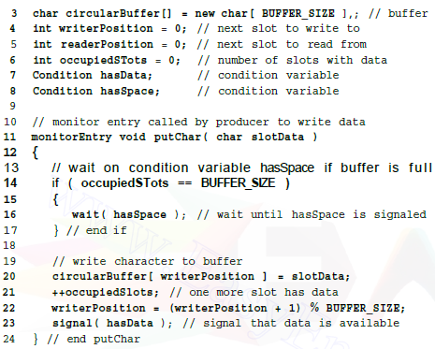
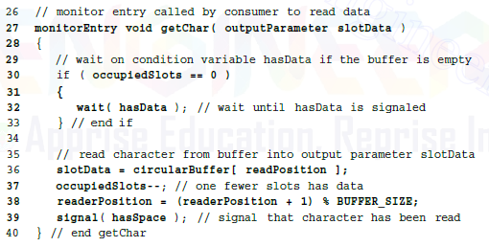
02_Monitors (6/9)
Monitor Example: Circular Buffer

Slide 11
02_Monitors (7/9)
Monitor Example: Readers and Writers
Readers
Do not change the contents of the database
Many readers may access the database at once
When a reader wishes to read
Calls monitor entry routine
A new reader can proceed as long as no thread is writing and no writer thread is waiting to write
When a reader is done reading, it calls monitor entry routine, in turn, signals the next waiting reader to proceed
Writer
Can modify the data
Must have exclusive access

Slide 12
Reader/Writer
readers = 0;
writeLock = false;
queue(canWrite);
queue(canRead);
Reader
T_{n}
Writer
T_{n+1}
beginRead()
If writing, wait(canRead)
++readers
signal(canRead)
Read Database
endRead()
--readers
If there is no read, signal(canWrite)
beginWrite()
If reading or writing, wait(canWrite)
writeLock = true
Write Database
endWrite()
writeLock = false
If reader in queue , signal(canRead) else signal(canWrite)
_{Airline Ticketing Database}
wait
wait
signal
Oʻzbekiston
Кыргызстан
Deutschland
USA
Korea
Nigeria
canRead
canWrite
. . . | T_{n} | T₄ | T₂
T₃ | T₆ | T_{n+1} | . . .
signal
signal
signal
queue(): the boolean function which determines whether or not threads are waiting on the condition variable specified in its argument.

Slide 13
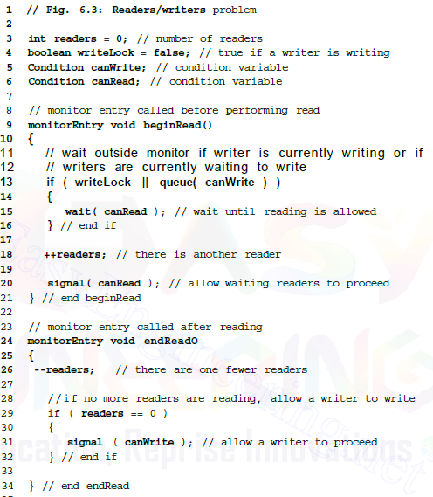
02_Monitors (8/9)
Monitor Example: Readers and Writers

Slide 14
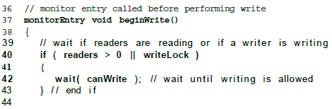
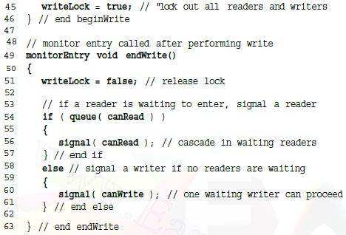
02_Monitors (9/9)
Monitor Example: Readers and Writers

Slide 15
03_Java Monitors (1/2)
Java Monitors
The primary mechanism to provide mutual exclusion and synchronization in multithreaded Java applications
Signal-and-continue Monitor
A thread inside the monitor to signal that the monitor will soon become available
Maintain a lock on the monitor until it exits
The keyword ‘synchronized’
Imposes mutual exclusion on an object in Java
When a thread attempts to execute a method protected
by a Java monitor (synchronized method), it must
first, enter that monitor's entry queue
Java Monitor
. . . | T₉ | T₅ | T₄ | T₂
[entry queue]
a queue of threads awaiting entry into the monitor

Slide 16
03_Java Monitors (2/2)
Java wait() method
Causes the thread to release the lock on the monitor and wait on an unnamed condition variable
A thread remains in the wait queue until notified by other threads
wait queue: a queue of threads waiting to reenter the monitor for the object
Java notify() and notifyAll() method
wakes a thread in the wait queue – notify()
The algorithm that determines which thread will enter the monitor next varies, depending on the Java virtual machine(JVM) implementation
Java Monitor
. . . | T₉ | T₅ | T₄ | T₂
[wait queue]
a queue of threads waiting to reenter the monitor for the object

Slide 17
04_Java Multithreading Case Study : Part III: (1/7)
Java SynchronizedBuffer
A Producer and a Consumer accessing a single shared buffer, with synchronization provided by a monitor
the Producer produces a new value only when the buffer is empty
the Consumer consumes a value only when the buffer is full
Java monitor with synchronized method
set() method, get() method
Only one thread can enter any of these get(), set() methods at a time on a particular SynchronizedBuffer object

Slide 18
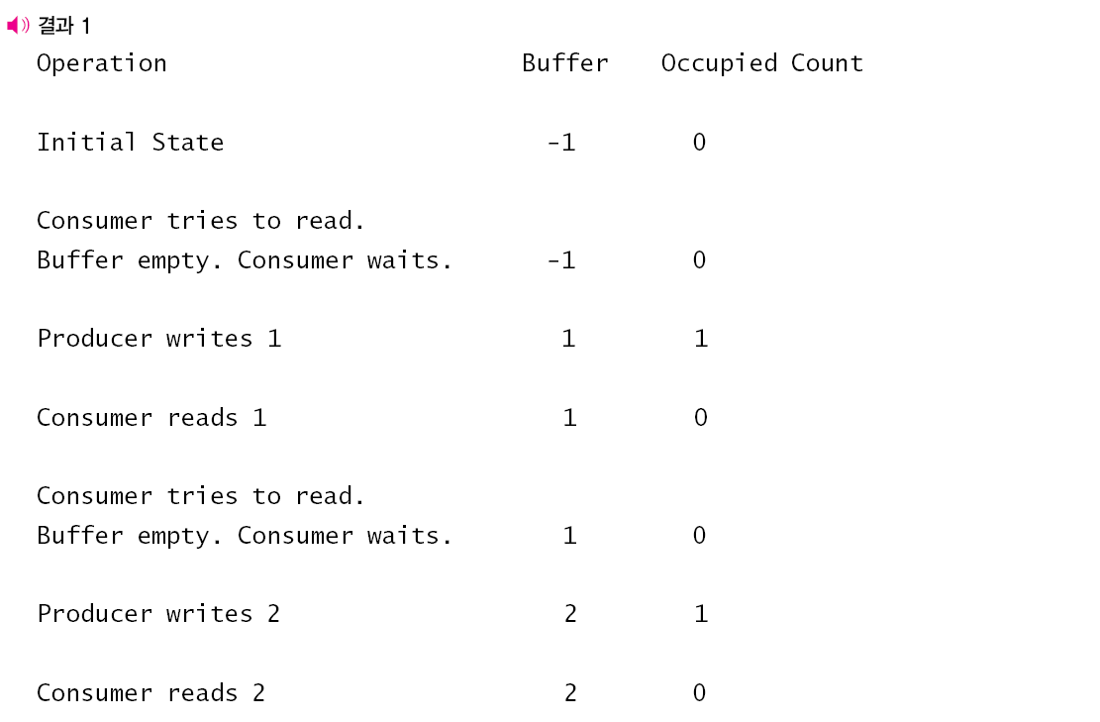
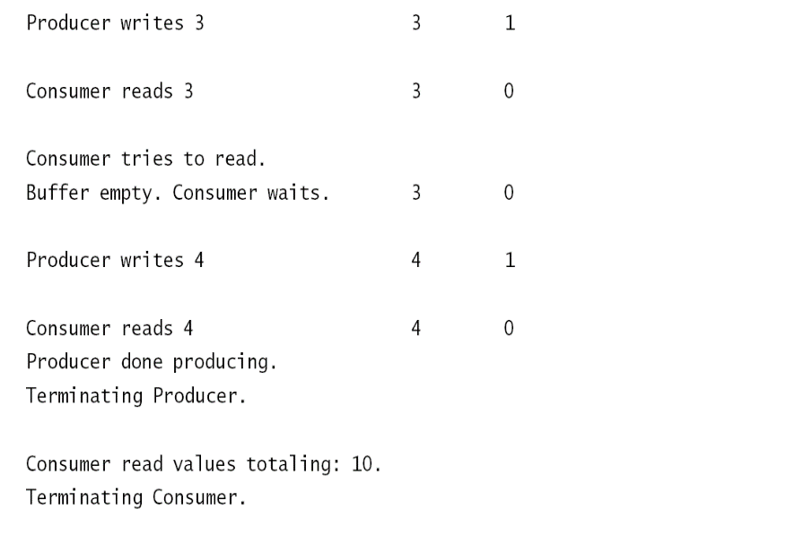
Synchronized Buffer
Producer P_{n}
Consumer
C_{n+1}
get calling thread name
while(buffer is full) - print waiting message - wait()
set(value) increment buffer count print set value
notify()
get calling thread name
while(buffer is empty) - print waiting message - wait()
decrement buffer count print get value
notify()
return value
set()
method
SynchronizedBuffer
get()
method
buffer
Write value
Read value
notify
notify
wait queue
P₂
C₄
C₉
P₅
. . .
wait
wait
P_{n}
C_{n+1}

Slide 19
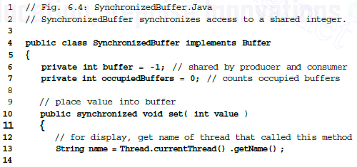
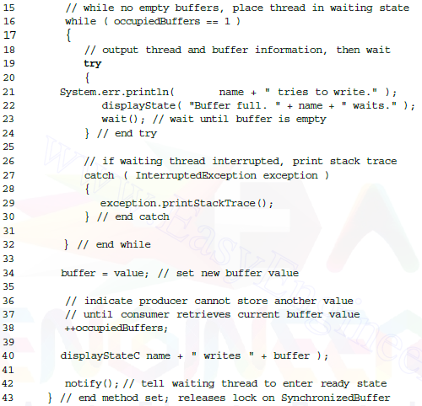
04_Java Multithreading Case Study : Part III: (2/7)

Slide 20
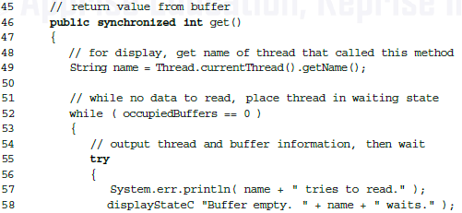
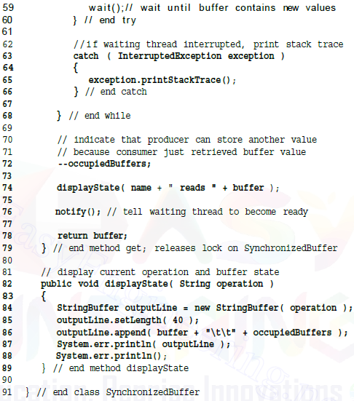
04_Java Multithreading Case Study : Part III: (3/7)

Slide 21
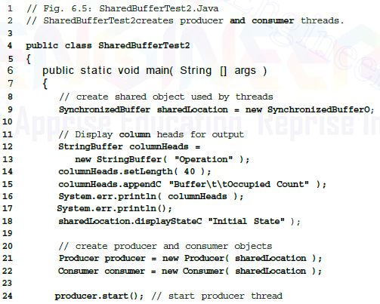

04_Java Multithreading Case Study : Part III: (4/7)

Slide 22

04_Java Multithreading Case Study : Part III: (5/7)

Slide 23
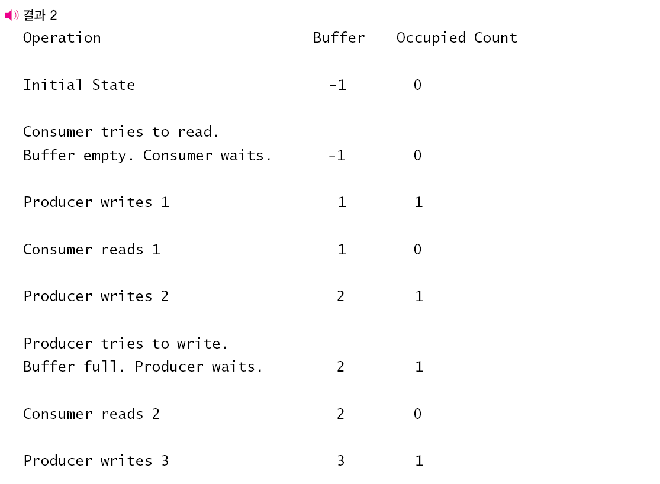
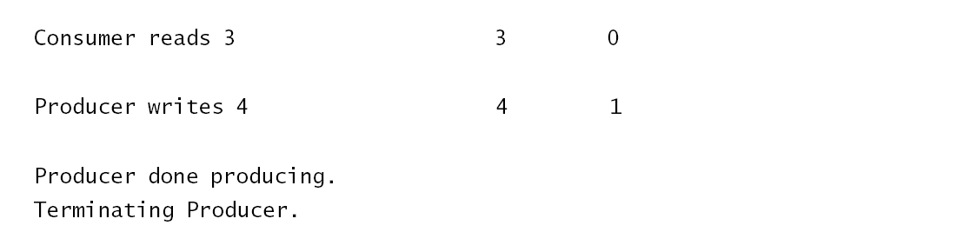
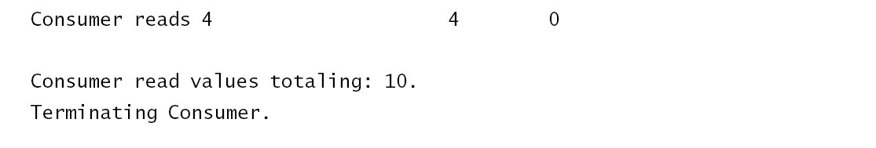
04_Java Multithreading Case Study : Part III: (6/7)

Slide 24
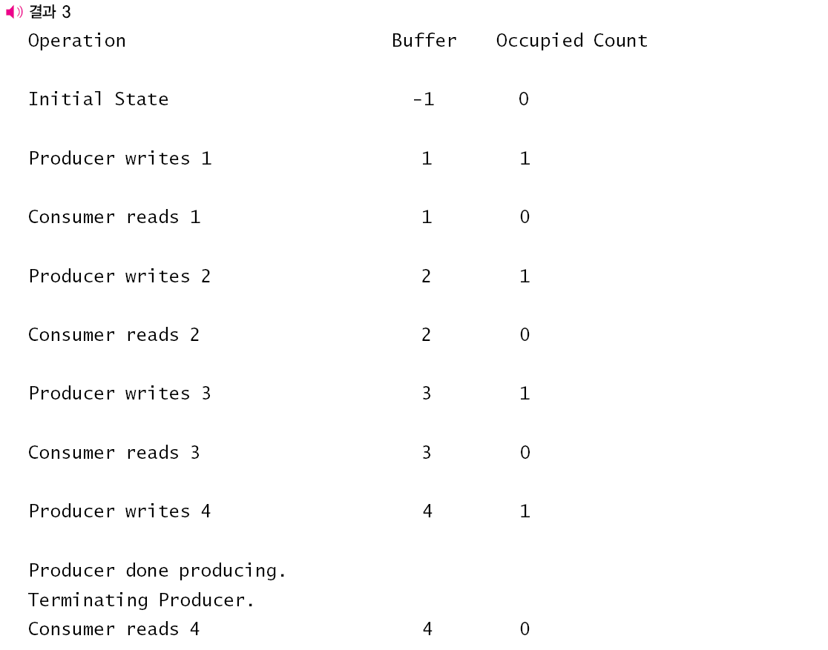

04_Java Multithreading Case Study : Part III: (7/7)

Slide 25
05_Java Multithreading Case Study : Part IV: (1/8)
Issue with a single buffer
If the two threads operate at different speeds, one of them will spend more (or even most) of its time waiting
Solution - a circular buffer that provides extra buffer slots
the producer can place values at times when it is running faster than the consumer
the consumer can retrieve those values when it is running faster than the producer
The number of buffer slots
If too small, threads will wait more
if too large, waste memory
Example
Demonstrates a producer and a consumer accessing a circular buffer (a shared array of three cells) with synchronization
the consumer consumes a value only when the array is not empty and the producer produces a value only when the array is not full

Slide 26
Circular Buffer
Producer P_{n}
Consumer
C_{n+1}
_{occupiedBuffers=0}
get calling thread name
while(buffer is full) - print waiting message - wait()
set value print set value increment buffer count advance writeLocation print shared buffer
notify()
12
10
-1
get calling thread name
while(buffer is empty) - print waiting message - wait()
get value print get value decrement buffer count advance readLocation print shared buffer
notify()
return value
_{readLocation}
0
set()
method
_{writeLocation}
2
1
get()
method
Buffers[]
notify
wait queue
notify
P₂
C₄
C₉
P₅
. . .
wait
wait
P_{n}
C_{n+1}

Slide 27

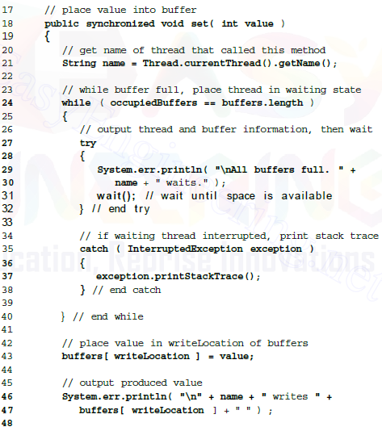
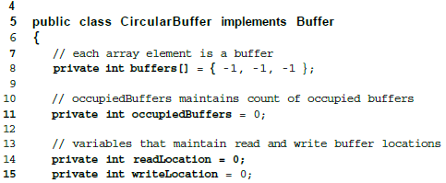

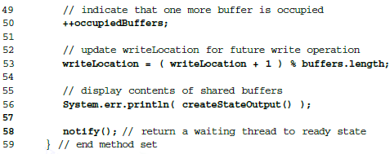
05_Java Multithreading Case Study : Part IV: (2/8)

Slide 28
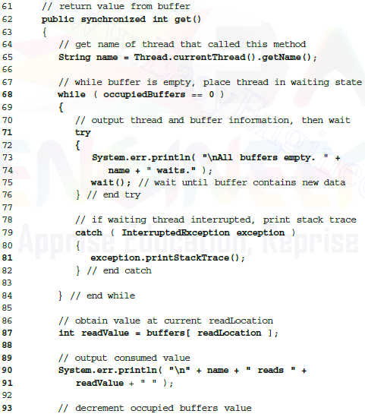
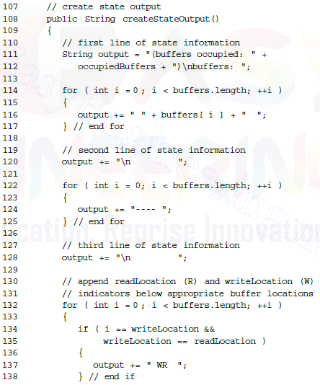
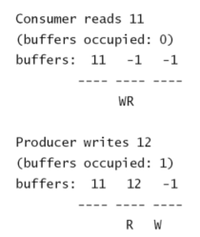
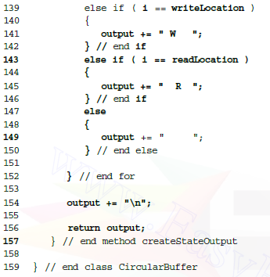
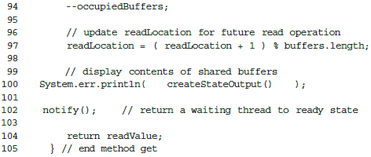
05_Java Multithreading Case Study : Part IV: (3/8)

Slide 29
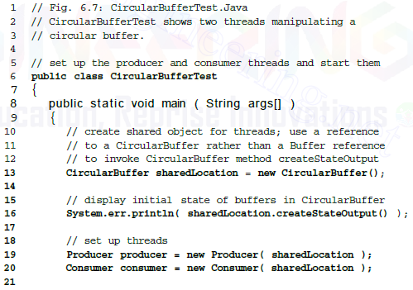

05_Java Multithreading Case Study : Part IV: (4/8)

Slide 30
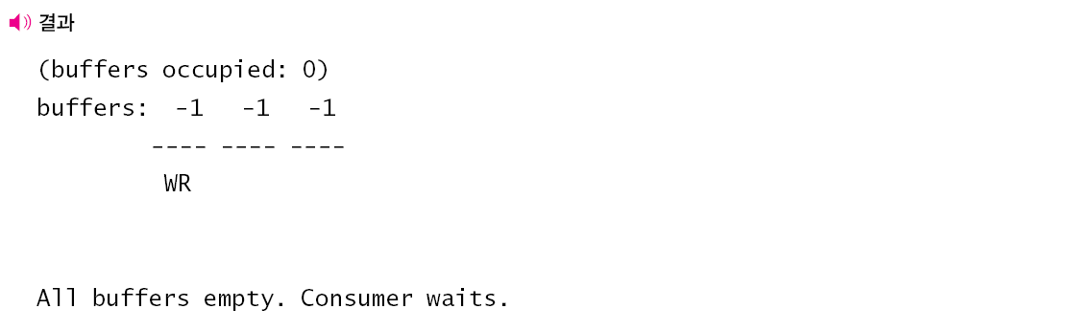
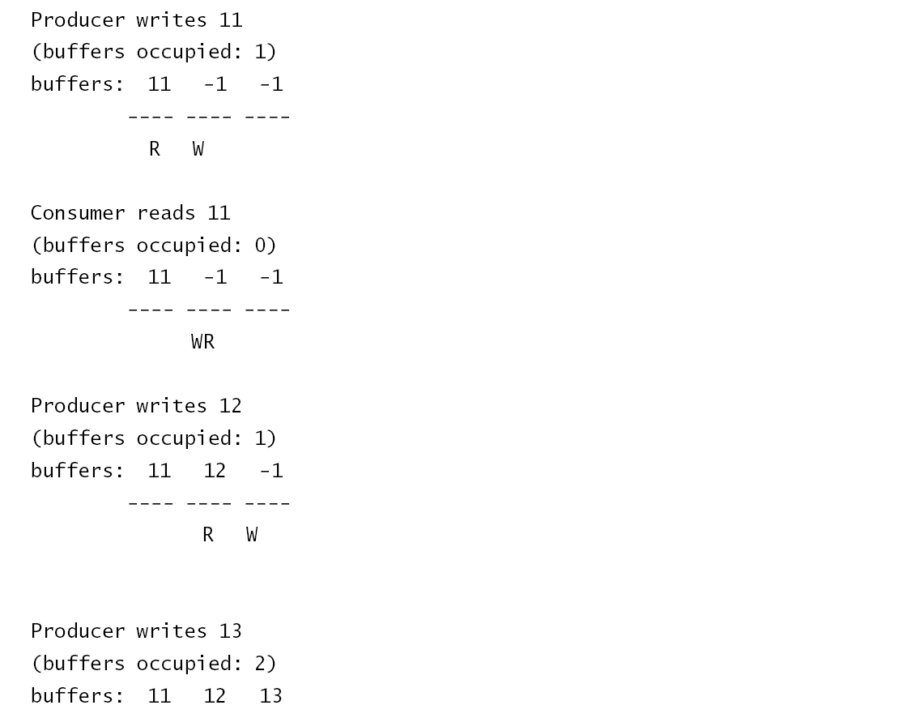
05_Java Multithreading Case Study : Part IV: (5/8)

Slide 31
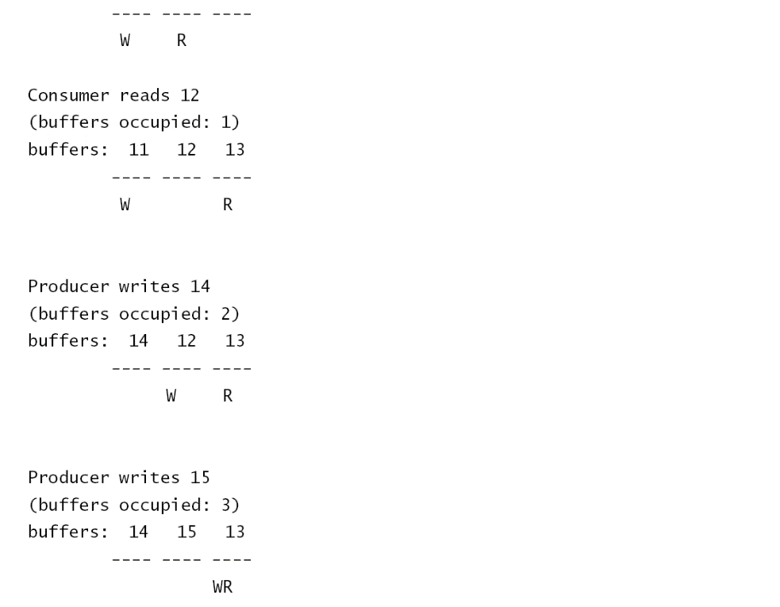
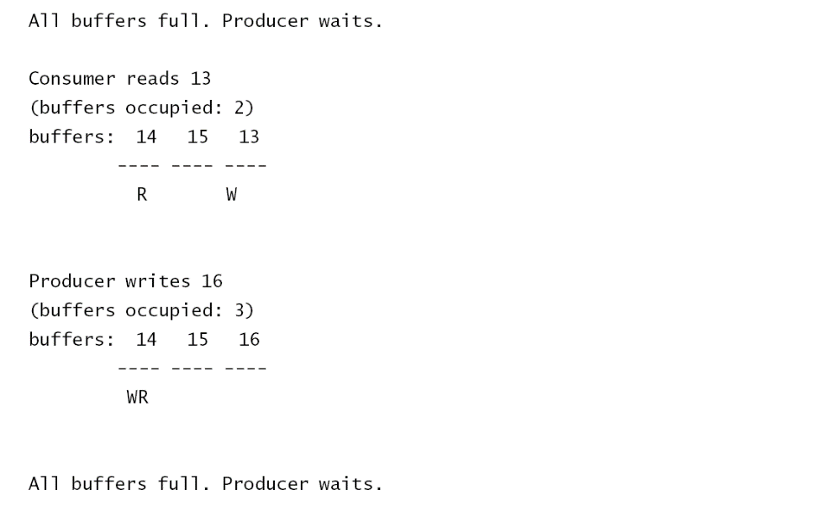
05_Java Multithreading Case Study : Part IV: (6/8)

Slide 32
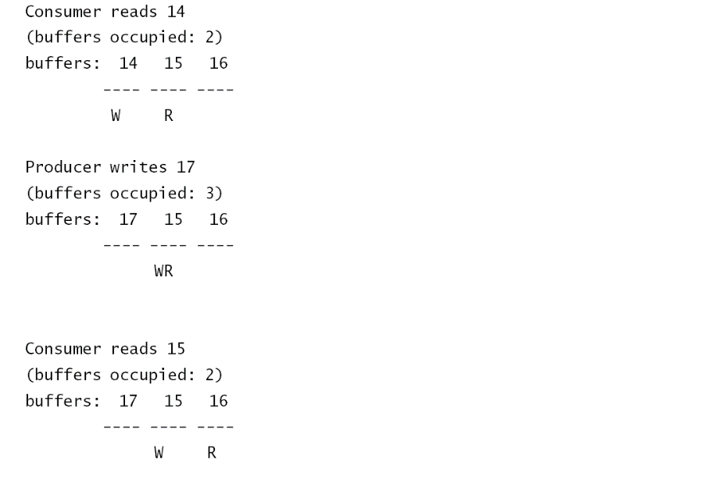
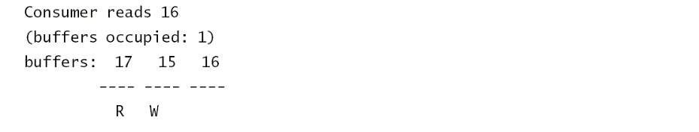
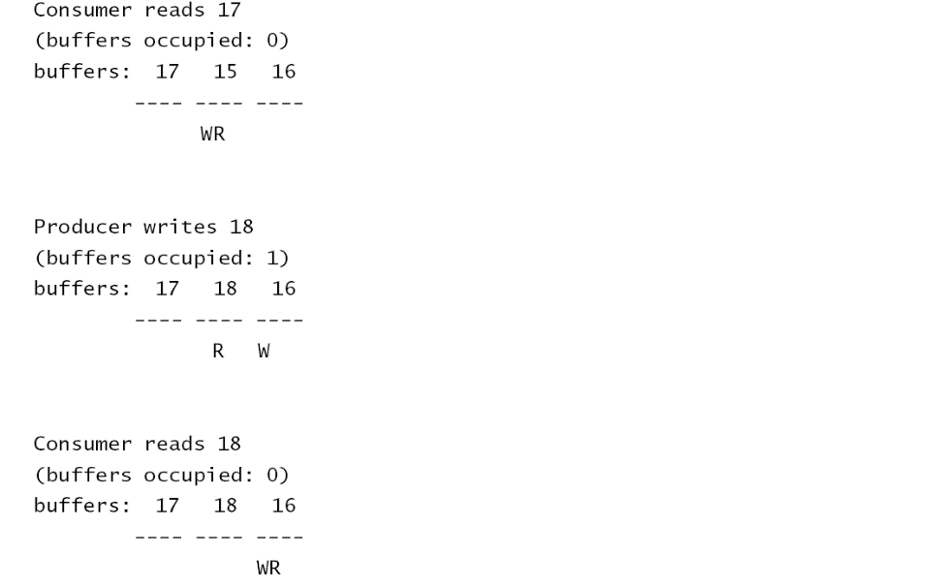
05_Java Multithreading Case Study : Part IV: (7/8)

Slide 33
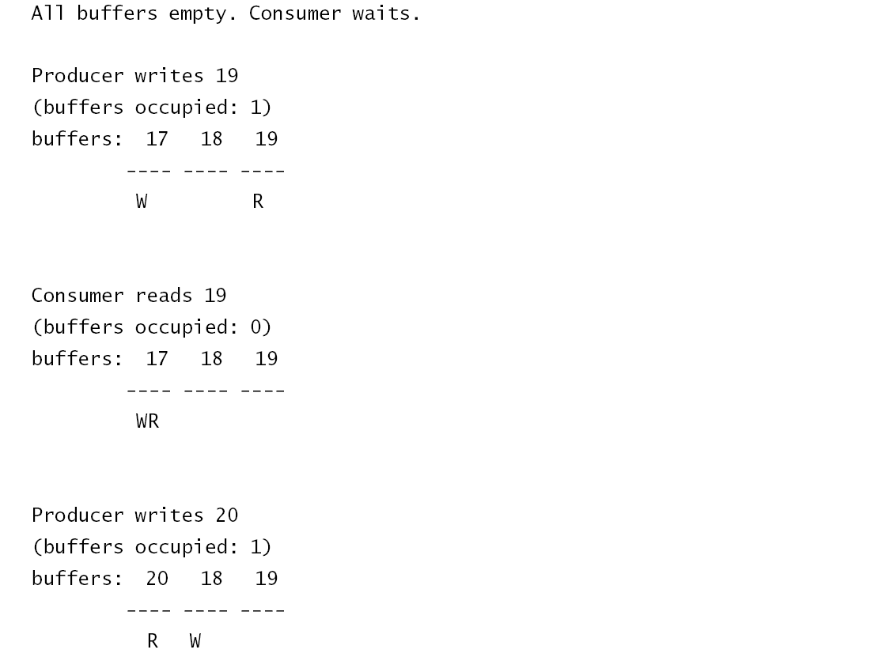
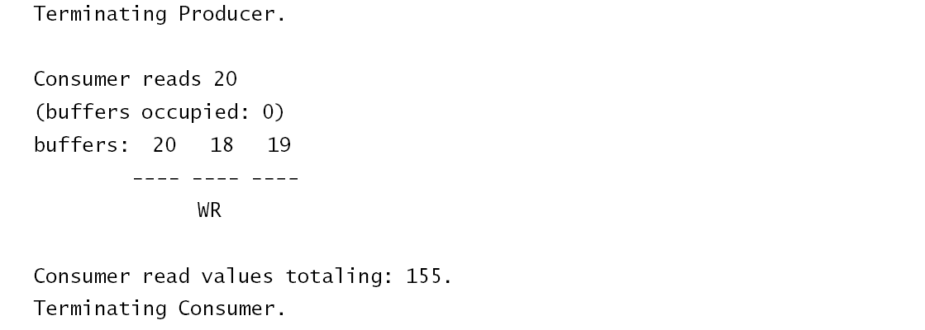
05_Java Multithreading Case Study : Part IV: (8/8)

